Slide 1
How to code control statements

Slide 2
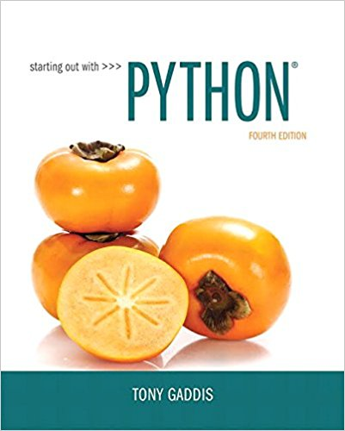
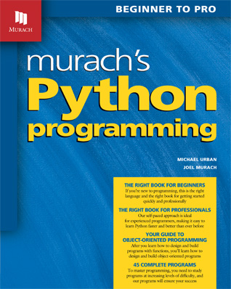
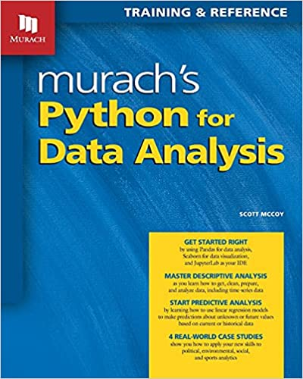
Slides are taken and adapted from:

Slide 3
Topics- Part 1 Selection
The if Statement
The if-else Statement
Comparing Strings
Nested Decision Structures and the if-elif-else Statement
Logical Operators
Boolean Variables

Slide 4
The if Statement
Control structure: logical design that controls order in which set of statements execute
Sequence structure: set of statements that execute in the order they appear
Decision structure: specific action(s) performed only if a condition exists
Also known as selection structure

Slide 5
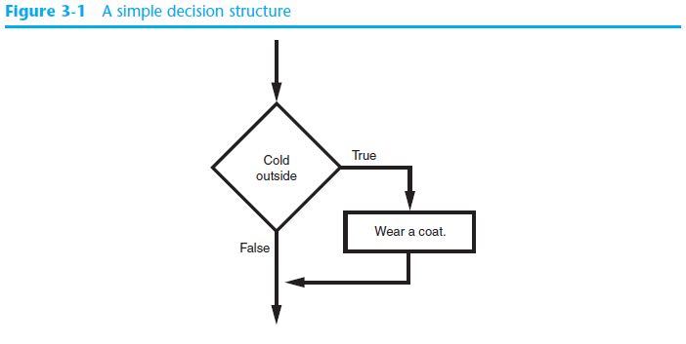
The if Statement (cont’d.)
Single alternative decision structure: provides only one alternative path of execution
If condition is not true, exit the structure

Slide 6
The if Statement (cont’d.)
Python syntax:
if condition:
Statement
Statement
First line known as the if clause
Includes the keyword if followed by condition
The condition can be true or false
When the if statement executes, the condition is tested, and if it is true the block statements are executed. otherwise, block statements are skipped

Slide 7
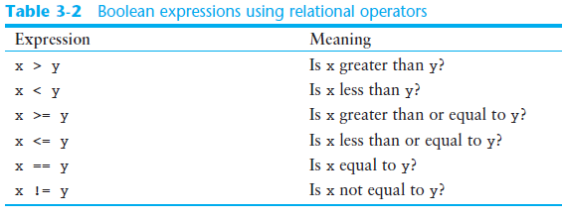
Boolean Expressions and Relational Operators (cont’d.)

Slide 8
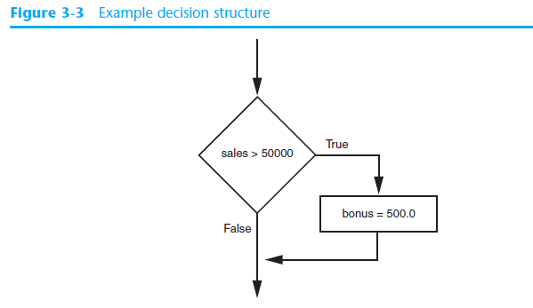
Boolean Expressions and Relational Operators (cont’d.)
Using a Boolean expression with the > relational operator

Slide 9
Exercise
Write a program to find the absolute value of a number entered by the user.

Slide 10
The if-else Statement
Dual alternative decision structure: two possible paths of execution
One is taken if the condition is true, and the other if the condition is false
Syntax: if condition:
statements
else:
other statements
if clause and else clause must be aligned
Statements must be consistently indented

Slide 11
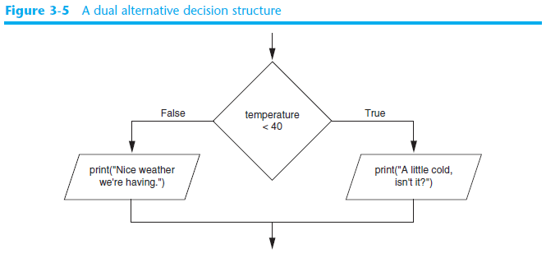
The if-else Statement (cont’d.)

Slide 12
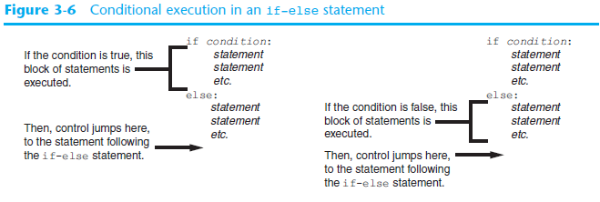
The if-else Statement (cont’d.)

Slide 13
An if statement that validates the customer type

Slide 14
Exercise
Write a program to input an integer number. The program should then output the number and a message saying whether the number is positive, negative, or zero.

Slide 15
Logical Operators
Logical operators: operators that can be used to create complex Boolean expressions
and operator and or operator: binary operators, connect two Boolean expressions into a compound Boolean expression
not operator: unary operator, reverses the truth of its Boolean operand

Slide 16
The and Operator
Takes two Boolean expressions as operands
Creates compound Boolean expression that is true only when both sub expressions are true
Can be used to simplify nested decision structures
Truth table for the and operator
Value of the Expression | Expression
false | false and false
false | false and true
false | true and false
true | true and true

Slide 17
The or Operator
Takes two Boolean expressions as operands
Creates compound Boolean expression that is true when either of the sub expressions is true
Can be used to simplify nested decision structures
Truth table for the or operator
Value of the Expression | Expression
false | false and false
true | false and true
true | true and false
true | true and true

Slide 18
Short-Circuit Evaluation
Short circuit evaluation: deciding the value of a compound Boolean expression after evaluating only one sub expression
Performed by the or and and operators
For or operator: If left operand is true, compound expression is true. Otherwise, evaluate right operand
For and operator: If left operand is false, compound expression is false. Otherwise, evaluate right operand

Slide 19
The not Operator
Takes one Boolean expressions as operand and reverses its logical value
Sometimes it may be necessary to place parentheses around an expression to clarify to what you are applying the not operator
Truth table for the not operator
Value of the Expression | Expression
false | true
true | false

Slide 20
An if statement that validates the range of a score

Slide 21
Exercise
Input the customer name and gender and greet the customer as Mr. or Ms. followed by their last name (have your code work for F or f or M or m).
Write a program to input three numbers and print out the largest number.

Slide 22
Nested Decision Structures and the if-elif-else Statement
A decision structure can be nested inside another decision structure
Commonly needed in programs
Example:
Determine if someone qualifies for a loan, they must meet two conditions:
Must earn at least $30,000/year
Must have been employed for at least two years
Check first condition, and if it is true, check second condition

Slide 23
Nested Decision Structures and the if-elif-else Statement (cont’d.)
Important to use proper indentation in a nested decision structure
Important for Python interpreter
Makes code more readable for programmer
Rules for writing nested if statements:
else clause should align with matching if clause
Statements in each block must be consistently indented

Slide 24
The if-elif-else Statement
if-elif-else statement: special version of a decision structure
Makes logic of nested decision structures simpler to write
Can include multiple elif statements
Syntax:
if condition_1:
statement(s)
elif condition_2:
statement(s)
elif condition_3:
statement(s)
else
statement(s)
Insert as many elif clauses
as necessary.

Slide 25
The if-elif-else Statement (cont’d.)
Alignment used with if-elif-else statement:
if, elif, and else clauses are all aligned
Conditionally executed blocks are consistently indented
if-elif-else statement is never required, but logic easier to follow
Can be accomplished by nested if-else
Code can become complex, and indentation can cause problematic long lines

Slide 26
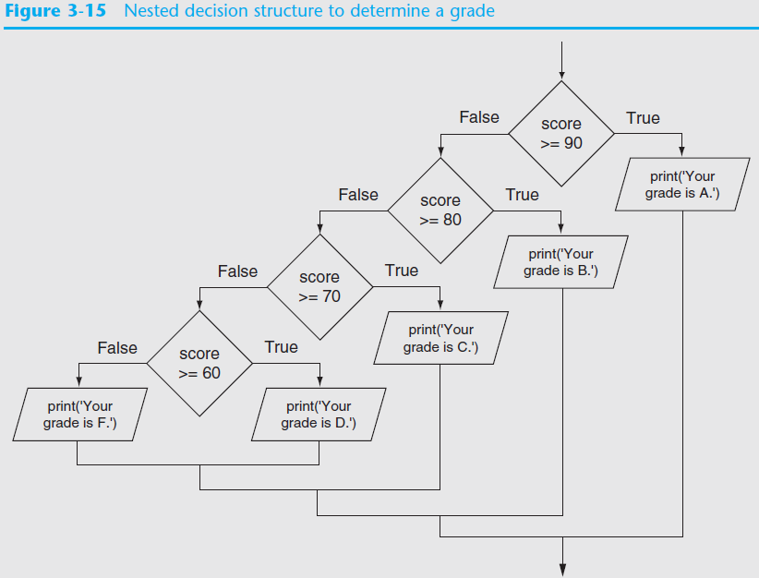

Slide 27
An if statement used for grading

Slide 28
Exercise
Input temp, if 80 <= temp <=100, swim, if 60 <= temp <80, play golf, temp < 60 eat, temp >100 , nap

Slide 29
Comparing Strings
Strings can be compared using the == and != operators
String comparisons are case sensitive
Strings can be compared using >, <, >=, and <=
Compared character by character based on the ASCII values for each character
If shorter word is substring of longer word, longer word is greater than shorter word

Slide 30
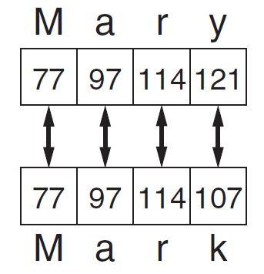
Comparing Strings (cont’d.)

Slide 31
Some string comparisons

Slide 32
Two string methods

Slide 33
How the lower() method can simplify code

Slide 34
The user interface with invalid data

Slide 35
The code

Slide 36
The user interface

Slide 37
The code

Slide 38
The code (cont.)

Slide 39
The code (cont.)

